Slide 1

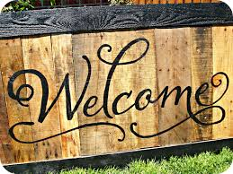


Slide 2
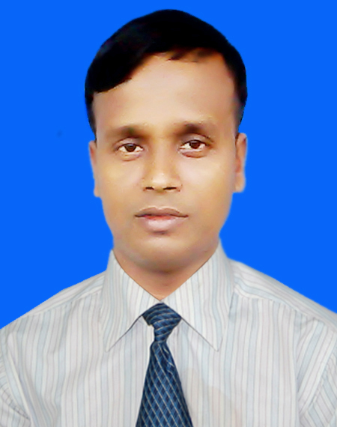
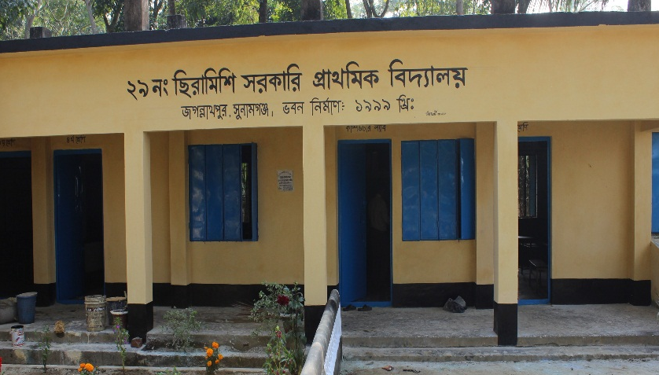
Md. Abdul Malik
Head teacher
Siramishi GPS
Jagannathpur, Sunamgonj.
Identity
Sub : English
Class: Three
Unit: 19
Lessons: 1-2

Slide 3

Learning out comes:
Students will be able to learn….
To build up vocabulary.
To develop their reading skill.
To develop their writing skill.

Slide 4
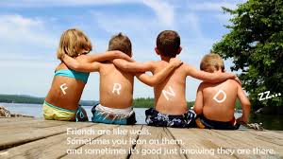

Warm up activity

Slide 5
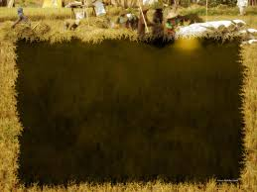
Today's lesson
Occupations

Slide 6
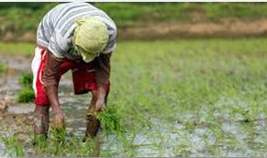
Farmer

Slide 7

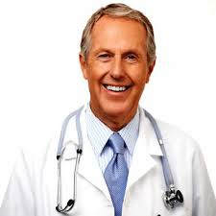
Doctor

Slide 8

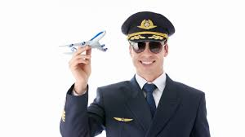
Pilot

Slide 9

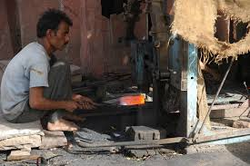
Blacksmith

Slide 10
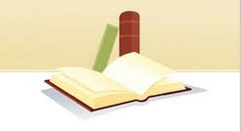
Look and say
Group work
Open your book at page at 38

Slide 11

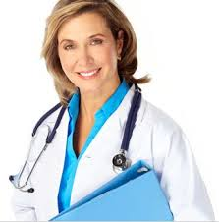
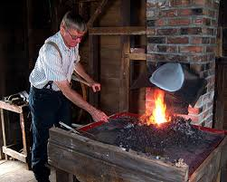
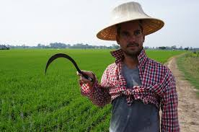
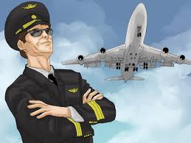
Match the word with the picture
PW
Farmer
Pilot
Doctor
Blacksmith

Slide 12

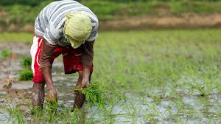

Read and match with the picture. Write the correct number in the box.
IW
A farmer grows food.
A doctor helps people.
A pilot flies a plane.
A blacksmith makes metal things.

Slide 13

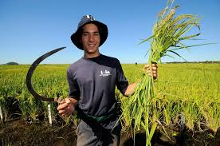
Write the name of the picture in your exercise book.

Slide 14
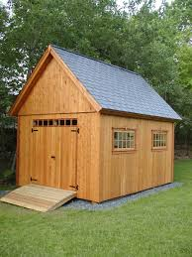
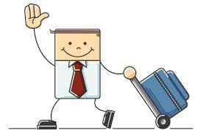

Slide 15



